Slide 1
Jaguar Land Rover Case Study
Team Members:-
Sumit Singh Rajpoot
Ashish Rana
Nooman Khan
Akash Kumar Shadangi

Slide 2
About Jaguar Land Rover:-
History of Jaguar Land Rover:-
Both Companies have been part of British Leyland for parts of their history until 1984, Jaguar Cars and Land Rover were eventually reunited into the same group by the Ford Motor Company in 2002. Ford acquired Jaguar Cars in 1989 and then Land Rover from BMW in 2000. In 2006, Ford purchased the Rover brand name from BMW for around £6 million. This reunited the Rover and Land Rover brands for the first time since the Rover group was broken up by BMW in 2000.
On 18 January 2008, Tata Motors, a part of the Tata Group, established Jaguar Land Rover Limited as a British-registered and wholly-owned subsidiary. The new company was to be used as a holding company for the acquisition from Ford of the two businesses – Jaguar Cars Limited and Land Rover for US$2.23 billion. That acquisition was completed on 2 June 2008. Included in the deal to buy Land Rover and Jaguar Cars were the rights to three other British brands: the Daimler marque, as well as two dormant brands Lanchester and Rover.

Slide 3
About Jaguar Land Rover:-
What was Jaguar Land Rover?
Jaguar Land Rover Automotive PLC is the holding company of Jaguar Land Rover Limited and is a British multinational automobile manufacturer which produces luxury vehicles and sport utility vehicles. Jaguar Land Rover is a subsidiary of Tata Motors Limited and has its head office in Whitley, Coventry, UK.
Company Size-
Jaguar Land Rover has been a wholly-owned subsidiary of Tata Motors.
The company employs almost 38,000 people globally and supports around 275,000 more through our retailers, suppliers, and local businesses.
JLR’s operating revenues range is Over INR 500 cr for the financial year ending on 31 March 2021. Its EBITDA has increased by 1,239.65 % over the previous year. At the same time, its book net worth has increased by 19.85 %

Slide 4
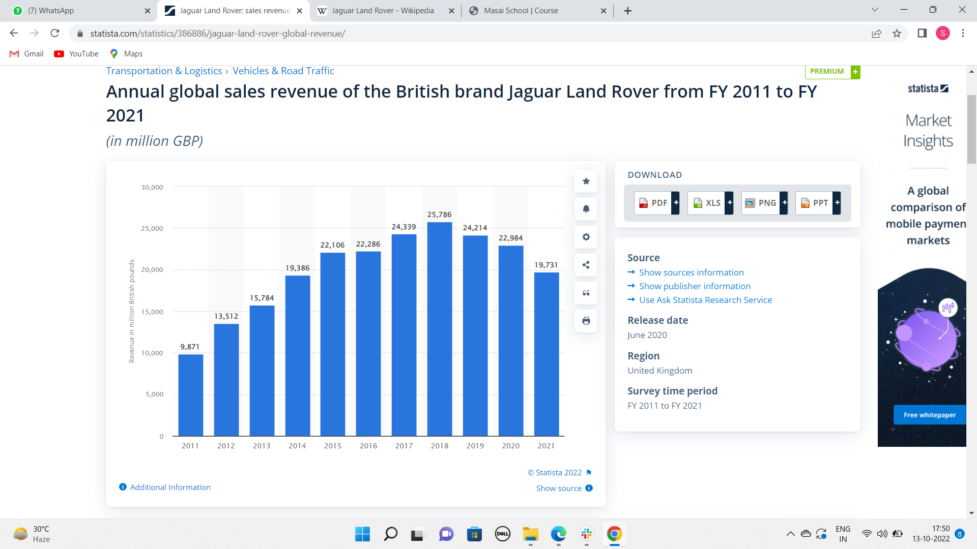
About Jaguar Land Rover:-
YOY analysis of Revenue:-

Slide 5
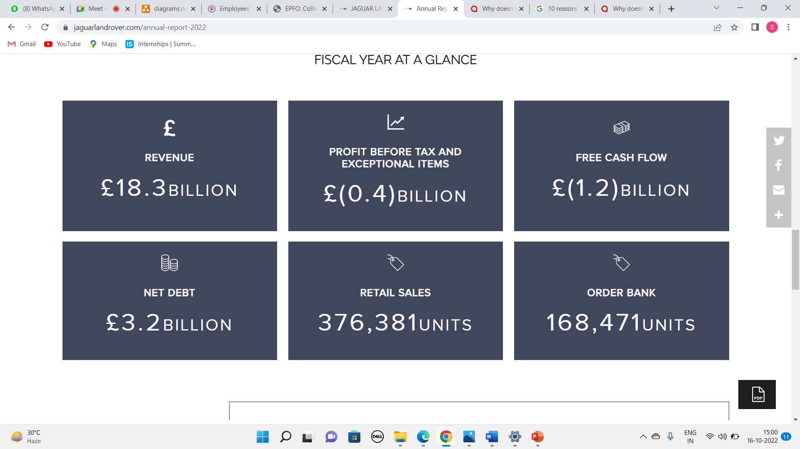
About Jaguar Land Rover:-
Annual report 2022:-
11

Slide 6
About Current Scenario
Current Manufacturing Strategy:-
Jaguar Land Rover Using Aerospace Technology To Develop Future Lightweight Vehicles
Technology developed for aerospace is repurposed to accelerate Jaguar Land Rover’s testing and development programs
Jaguar Land Rover to take part in pioneering all-weather, all-terrain tests of new metals and composites
Two-year project will ensure new body materials deliver a longer-lasting, high-quality finish
Jaguar LandRover Announces Partnership With NVIDIA
Jaguar Land Rover has formed a multi-year strategic partnership with NVIDIA, the leader in artificial intelligence (AI) and computing, to jointly develop and deliver next-generation automated driving systems plus AI-enabled services and experiences for its customers. Starting in 2025, all new Jaguar and Land Rover vehicles will be built on the NVIDIA DRIVE software-defined platform—delivering a wide spectrum of active safety, automated driving, and parking systems as well as driver assistance systems

Slide 7
About Current Scenario
Current Manufacturing Strategy:-
Switched to "Open Innovation strategy", to accelerate next-generation technology and sustainability to support its modern luxury vision for the business, its partners, and customers
With the launch of the Open Innovation platform, JLR is looking at the entire mobility and sustainability ecosystem to offer an unparalleled customer experience, shaping the future of our industry, and paving the way to the future

Slide 8
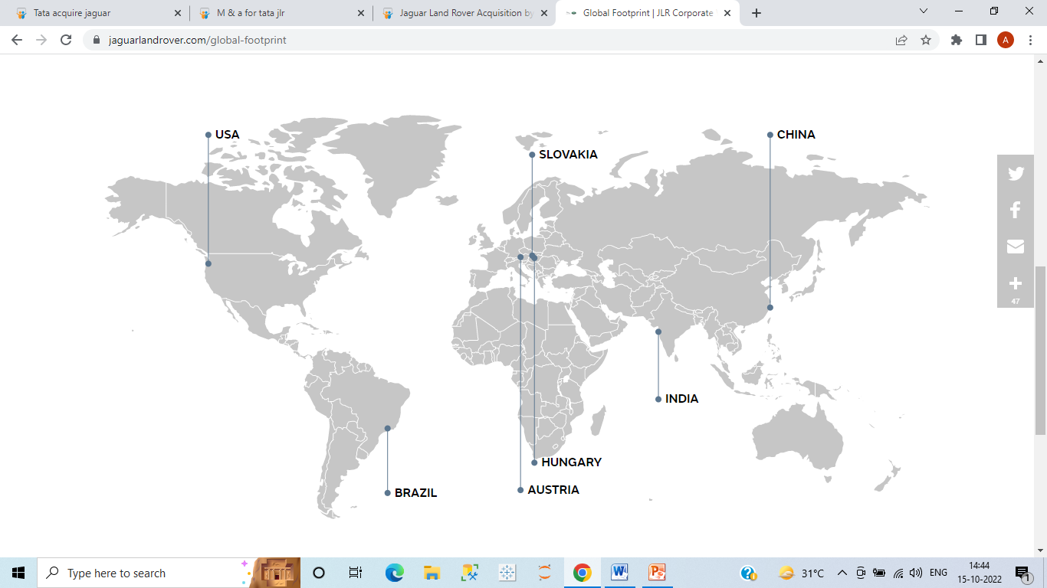
About Current Scenario
Global Market Presence

Slide 9
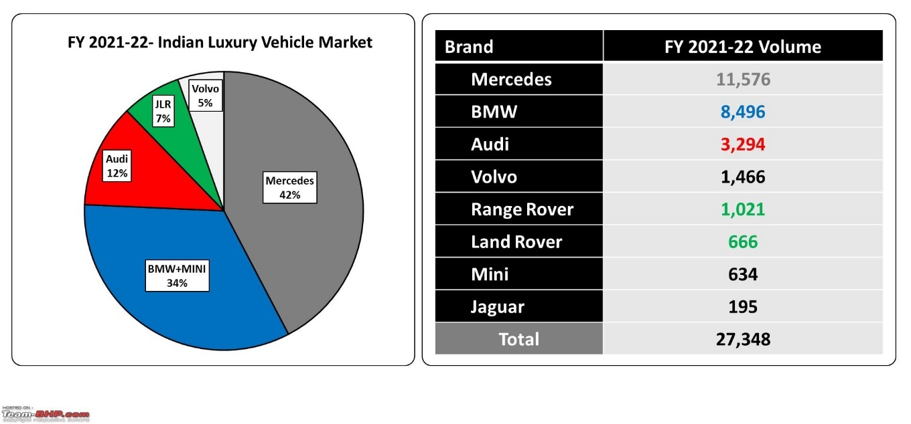
JLR performance in India

Slide 10
IF JLR Start manufacturing in India

Slide 11
Market Size of Luxury in India
Currently Indian Users of JLR:-(Approximate)
Population of India = 1.4B
Rural-70%, =98cr
Urban-30%,=42cr
In rural-
BPL = 20%=19.6 cr
LOW = 45%=44.1cr
Lower middle =30 %=29.4cr
Upper middle = 5%=4.9 cr in the upper middle 5% of the population can afford luxury car= 2.5m(approx.)
assume 5 members in a family =2.5m/5=.5m(approx.)
In urban-
lower - 35%=14.7cr
Middle -55%=23.1 cr
High-10%=4.2 cr *70%=2.94cr/5=5.5m(approx.)
Indian market for luxury cars =.5+5.5=6m(approx.)

Slide 12
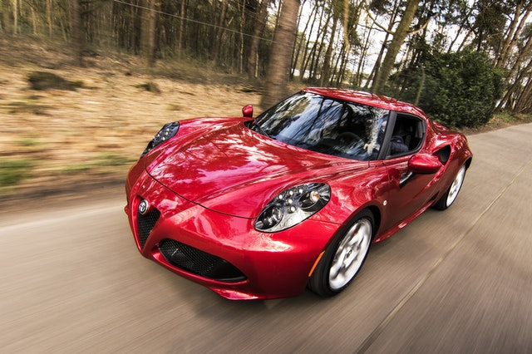
Customer Demands in Luxury Cars
5 Key Drivers That Accelerate Customer Experience:
Looks
Driveability
Premium Features(AI,etc)
Service
Engine

Slide 13
Competetors
Brand | Looks | Driveability | Features | Service | Engine | Market Cost | AVG cost
BMW | High | High | High | High | High | 34% | 80L
Mercedes | High | High | High | Low | High | 42% | 70L
Volvo | High | High | Moderate | Moderate | High | 5% | 70L
Audi | High | Moderate | High | High | Moderate | 12% | 60L

Slide 14
JLR
Looks | Driveability | Features | Services | Engine | Market Share | Avg Cost
High | High | Moderate | Moderate | High |  | 95L

Slide 15
Failure Mode Analysis
Reasons for failure, If JLR enters in Indian Market
JLR Lags behind its competitors in Service, Features, and Cost factors
If JLR Start manufacturing in India # of unit sold will be less

Slide 16
Cost Estimation of Plant
Cost sections | Percentage of cost
Research & development cost | 12-16% = 50M
Fixed cost | 50-57% = 56.5B
Variable cost | 10-15% = 14B
Marketing cost | 8-10% = 50M
Total Cost | 70.6 B

Slide 17
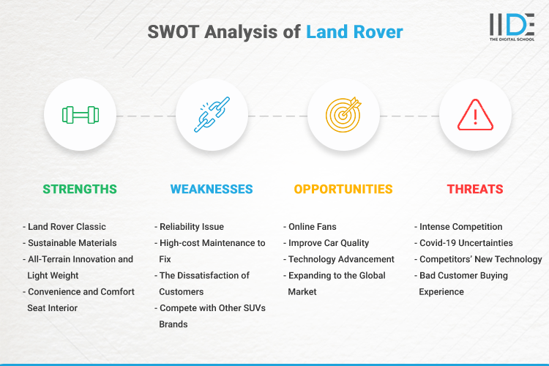
SWOT Analysis

Slide 18
Pricing of car
It is very difficult to calculate the total production cost of a car because of many variables.
Cost Value Chain
Raw material
Transportation
Storage
Production
Distribution/Marketing
After Sales Cost
Other Cost
Suppose the cost of the car 40L

Slide 19
The selling price of a car
To determine the selling price of a car, you have to add a fixed profit percentage to the total cost.
For example, you spent 40L to construct a car and you want to profit 20% on construction costs. So
Sales price = 4000000 + 20%
= 4.8M

Slide 20
Break Even Point
If 2 years take for complete construction after that
You can start manufacturing cars if you sell 500 cars in a month
500*4.8M = 2.4B
Break-even = 70/2.4+24 = 53.2 Month = 4.5 year

Slide 21
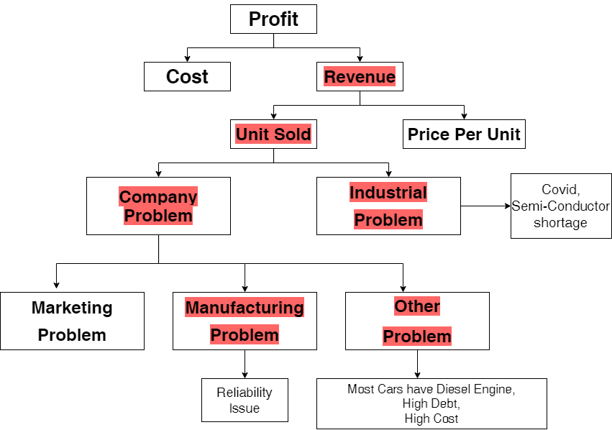
Profitability framework

Slide 22
Synthesis
Here are few key points JLR can take in order to attract customer and improve sales.
Hire High-qualified problem solvers/Engineers to Solve Reliability issues
Convert Diesel Car into Petrol or EVs because most customer demands are EV and the European government want to ban Diesel car due to high Carbon Emission.
Our Car cost as compared to other luxury brands is high e.g. – BMW, Mercedes, and Audi our cost should be comparable.

Slide 23
Benefits In India
IF JLR manufactures Cars in India and Export them to other Countries It will benefit JLR. Because manufacturing cost is less in India e.g. – Labour cost, Land, and Infrastructure.
Challenges faced:
Firstly to find out how big is Indian market for luxury cars.
Whether JLR can benefited or not if it starts manufacturing in India.
As our team members are working professional to get everybody on a particular time initially challenging but we managed to overcome and managed time accordingly.

Slide 24
Thank you

Slide 25
Any Question

